Slide 1
ANZ Bank Transaction Data Analysis
EDA of Customer transaction data using Python

Slide 2
About the Dataset
Includes details about the customer account
Includes details of the customer and merchant locations
Includes details about the transactions

Slide 3
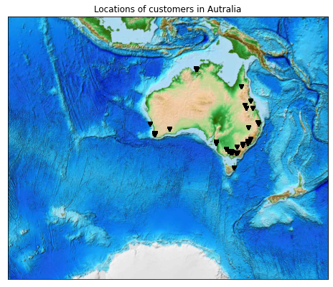
Location of customers
All the customers are from the coastline region of Australia

Slide 4
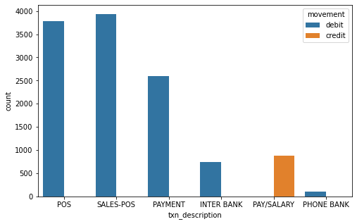
Total Number of transactions in a category.

Slide 5
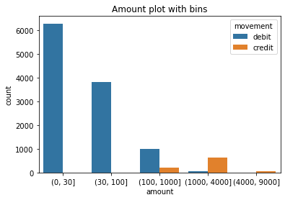
Number of transactions for a amount range.

Slide 6
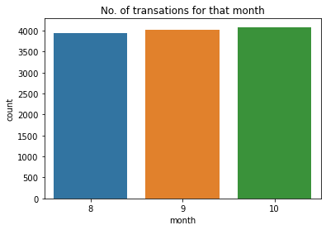
Number of transactions for a month.
Month | Number of Transactions
August | 3943
September | 4013
October | 4087

Slide 7
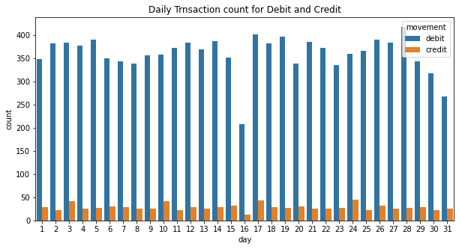
Date wise total transactions for 3 months.

Slide 8
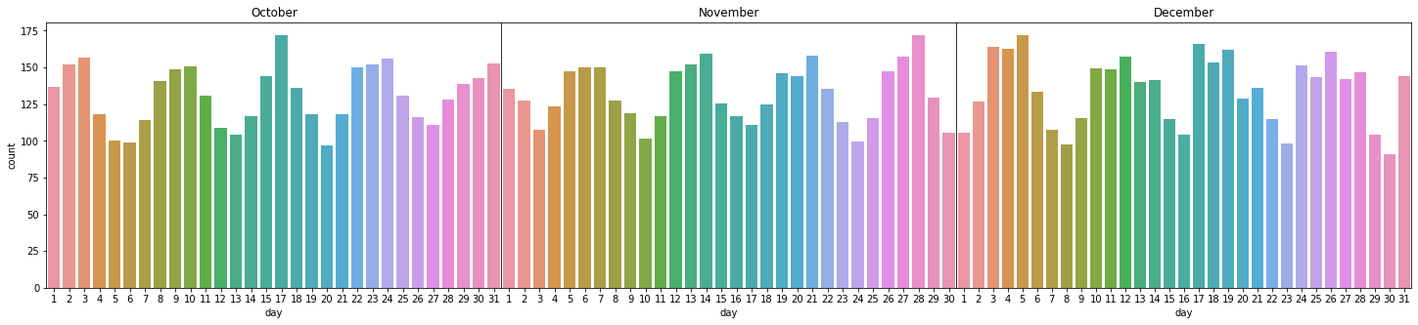
Date wise total transactions for each month.
We can visualize starting and ending of a week from the graph.

Slide 9
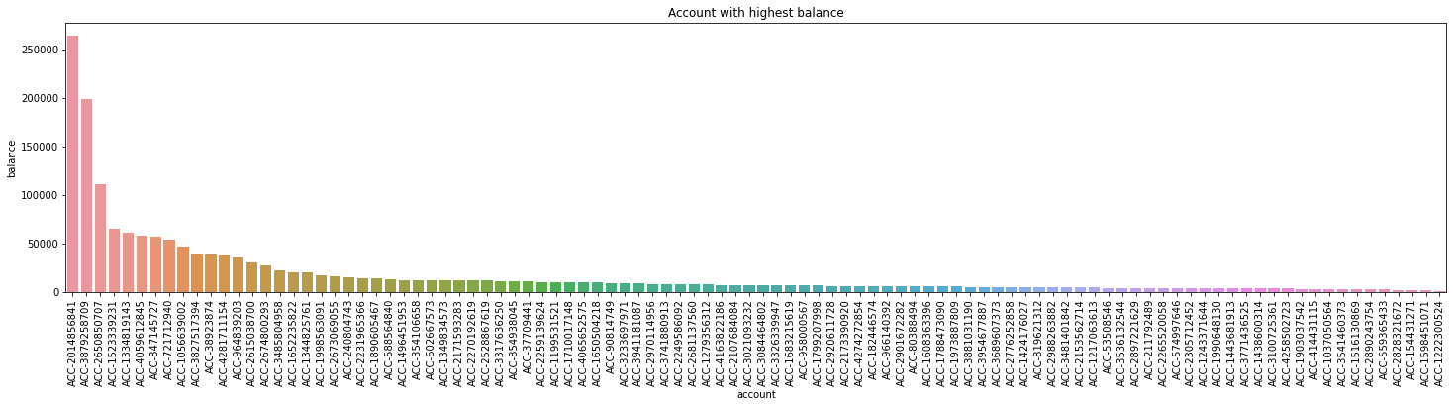
Account with balance from high to low.

Slide 10
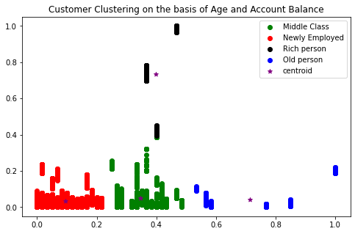
Clustering of Customers on the basis of Age and Account Balance
Cluster | No. of transactions
Newly Employed | 7226
Middle Class | 4123
Old person | 418
Rich person | 276
Scaled Balance
Scaled Age

Slide 11
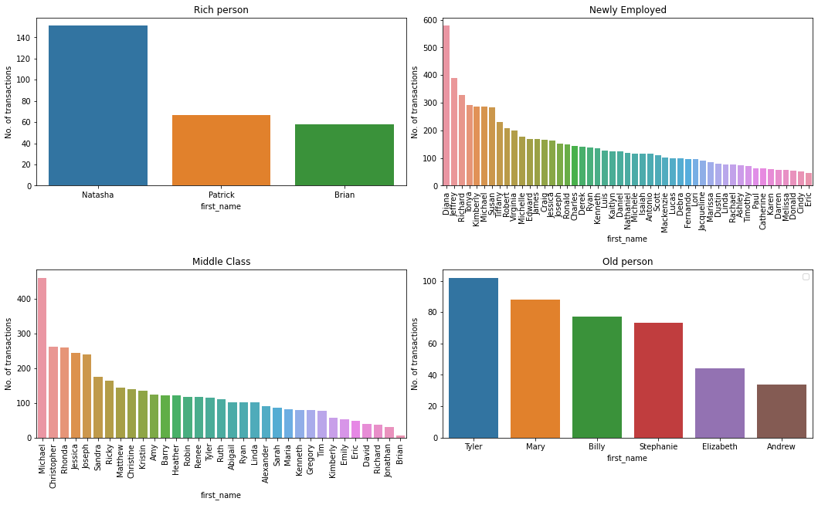
No. of Transactions by Customer with respect to there cluster.

Slide 12
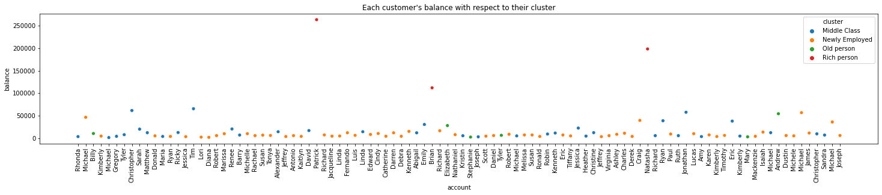
Each customer’s account balance with respect to their cluster
Clustering is very useful, as we get to know insights about our customers and we can target our customers.

Slide 13

Thank you
Samprati Kothari
Email: sampratikothari97@gmail.com

